Slide 1
Software Verification Validation and Testing
Presented by : Neha Tripathi

Slide 2
Bugs
Life cycle of a Bug
States of a Bug
Why do bugs occur
Cost of debugging
Classification of Bugs

Slide 3
Life cycle of a bug
Any member of the development team can make an error in any phase of SDLC.
If an error has been produced in the requirement specification phase and not detected in the same phase, then it results in a bug in the next phase, i.e. the design phase.
In the design phase, a bug has come from the previous stage, but an error can also be produced in this stage. Again, if the error in this phase is not detected and it passes on to the next stage, i.e. coding phase, then it becomes a bug.
In this way, errors and bugs appear and travel through various stages of SDLC.
It means, one stage may contain errors as well as bugs and the bugs which come from the previous stage are harder to detect and debug.
In the testing phase, we analyze the incidents when the failure occurs.
On the basis of symptoms derived from the incidents, a bug can be classified into certain categories.
After this, the bug can be isolated in the corresponding phase of SDLC and resolved by finding its exact location.

Slide 4
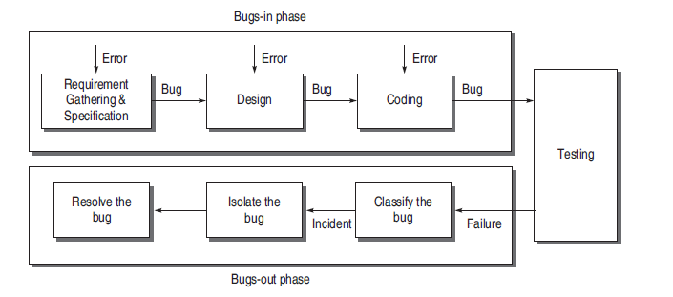
The whole life cycle of a bug can be classified into two phases:
(i) bugs-in phase and
(ii) bugs-out phase.

Slide 5
Bugs-In Phase
This phase is where the errors and bugs are introduced in the software. Whenever we commit a mistake, it creates errors on a specific location of the software and consequently, when this error goes unnoticed, it causes some conditions to fail, leading to a bug in the software. This bug is carried out to the subsequent phases of SDLC, if not detected. Thus, a phase may have its own errors as well as bugs received from the previous phase.
Bugs-Out Phase
If failures occur while testing a software product, we come to the conclusion that it is affected by bugs. In this phase, when we observe failures, the following activities are performed to get rid of the bugs:
-Bug Classification
-Bug Isolation
-Bug Resolution

Slide 6
Bug classification
Here, we observe the failure and classify the bugs according to its nature. A bug can be critical or catastrophic in nature or it may have no adverse effect on the output behavior of the software. In this way, we classify all the failures. This is necessary, because there may be many bugs to be resolved. But a tester may not have sufficient time. Thus, categorization of bugs may help by handling high criticality bugs first and considering other trivial bugs on the list later, if time permits.
Bug isolation
Bug isolation is the activity by which we locate the module in which the bug appears. Incidents observed in failures help in this activity. We observe the symptoms and back-trace the design of the software and reach the module/files and the condition inside it which has caused the bug. This is known as bug isolation.
Bug resolution
Once we have isolated the bug, we back-trace the design to pinpoint the location of the error. In this way, a bug is resolved when we have found the exact location of its occurrence.

Slide 7
States of a Bug
A Bug attains the following different states in its life cycle:
-New
-open
-Assign
-Deferred
-Rejected
-Test
-Verified/fixed
-Reopened
-Closed

Slide 8
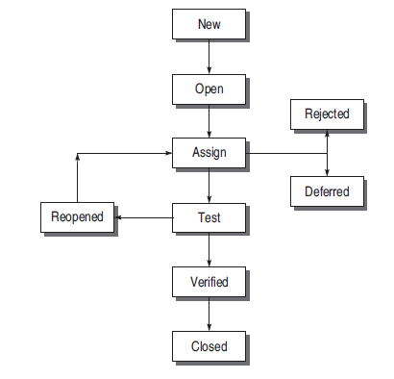
fig. : States of a Bug

Slide 9
New The state is new when the bug is reported first time by a tester.
Open The new state does not verify that the bug is genuine. When the test leader approves that the bug is genuine, its state becomes open.
Assign An open bug comes to the development team where the development team verifies it validity. If the bug is valid, a developer is assigned the job to fix it and the state of the bug now is ‘ASSIGN’.
Deferred The developer who has been assigned to fix the bug will check its validity and priority. If the priority of the reported bug is not high or there is not sufficient time to test it or the bug does not have any adverse effect on the software, then the bug is changed to deferred state which implies the bug is expected to be fixed in next releases.
Rejected It may be possible that the developer rejects the bug after checking its validity, as it is not a genuine one.

Slide 10
Test After fixing the valid bug, the developer sends it back to the testing team for next round of checking. Before releasing to the testing team, the developer changes the bug’s state to ‘TEST’. It specifies that the bug has been fixed by the development team but not tested and is released to the testing team.
Verified/fixed The tester tests the software and verifies whether the reported bug is fixed or not. After verifying, the developer approves that the bug is fixed and changes the status to ‘VERIFIED’.
Reopened If the bug is still there even after fixing it, the tester changes its status to ‘REOPENED’. The bug traverses the life cycle once again. In another case, a bug which has been closed earlier may be reopened if it appears again. In this case, the status will be REOPENED instead of OPEN.
Closed Once the tester and other team members are confirmed that the bug is completely eliminated, they change its status to ‘CLOSED’.

Slide 11
Why do bugs occur?
To Err is Human
Bugs in Earlier Stages go Undetected and Propagate

Slide 12
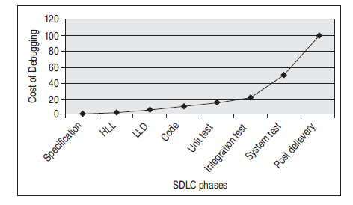
Cost of debugging increases if bug propagates

Slide 13
Bug Classification
Based on criticality
- Critical Bugs (For example, in a sorting program, after providing the input numbers, the system hangs and needs to be reset)
- Major Bug (For example, in a sorting program, the output is being displayed but not the correct one)
- Medium Bugs (e.g. redundant or truncated output, then the bug is a medium bug)
- Minor Bugs (For example, typographical error or misaligned printout)

Slide 14
Based on SDLC
- Requirements and Specifications Bugs (incomplete, ambiguous, or inconsistency)
- Design Bugs (control-flow , logic , processing , data-flow , error handling and user interface bug )
-Coding Bugs (undeclared data, undeclared routines, typographical errors, documentation bugs)
- Interface and Integration Bugs (parameters)
- System Bugs (bugs related to parameters like performance, stress, compatibility, usability, etc.)
- Testing Bugs (failure to notice/report a problem, failure to use the most promising test case, failure to make it clear how to reproduce the problem, failure to check for unresolved problems just before the release, failure to verify fixes, failure to provide summary report)

Slide 15
Thank You!

